Slide 1
Introduction to Java
BACS2023 Object-Oriented Programming
Appendix A1

Slide 2
Learning Outcomes
At the end of this chapter, you should be able to
Describe the relationship between Java and the World Wide Web (WWW).
Distinguish the terms API, IDE and JDK.
Compile and run a simple Java program.

Slide 3
Introduction
Java enables users to develop and deploy applications on the Internet for servers, desktop computers, and small hand-held devices.
The future of computing is being profoundly influenced by the Internet, and Java promises to remain a big part of that future.
Java is the Internet programming language.

Slide 4
Java, the WWW, and Beyond (1)
Java was developed by a team led by James Gosling at Sun Microsystems.
Originally called Oak, it was designed in 1991 for use in embedded consumer electronic appliances. It was renamed Java in 1995 and was redesigned for developing Internet applications.
Java is platform-independent, meaning that you can write a program once and run it anywhere.
Java is simple, object-oriented, distributed, interpreted, robust, secure, architecture-neutral, portable, high-performance, multi-threaded, and dynamic.

Slide 5
Java, the WWW, and Beyond (2)
Java is a full-featured, general-purpose programming language that is capable of developing robust mission-critical applications.
Today, it is used not only for Web programming, but also for developing standalone applications across platforms on servers, desktops, and mobile devices.
It was used to develop the code to communicate with and control the robotic rover that rolled on Mars.

Slide 6
Java, the WWW, and Beyond (3)
Many companies are now using Java to create distributed applications accessed by customers and partners across the Internet.
Java initially became attractive because Java programs (applets) can be run from a Web browser.
Applets use a modern graphical user interface with buttons, text fields, text areas, radio buttons, and so on, to interact with users on the Web and process their requests.

Slide 7
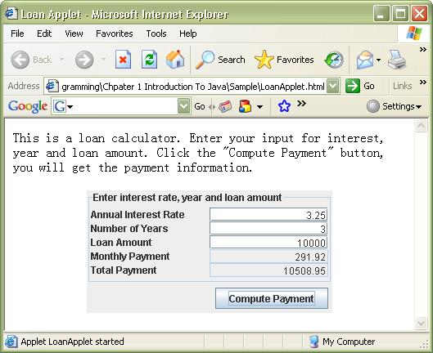
Java, the WWW, and Beyond (4)
Applets make the Web responsive, interactive, and fun to use.
The figure below shows an applet running from a Web browser.

Slide 8
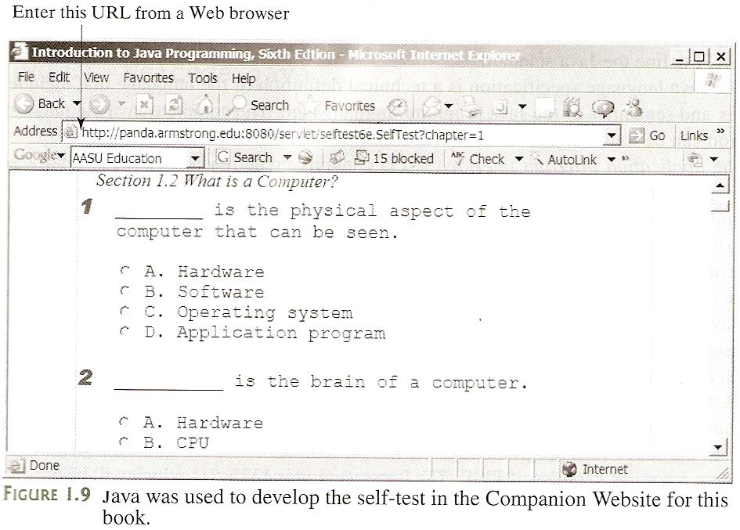
Java, the WWW, and Beyond (5)
Java can also be used to develop applications on the server side. These applications, called Java servlets or Java Server Pages (JSP), can be run from a Web server to generate dynamic Web pages.

Slide 9
Java, the WWW, and Beyond (6)
The Web pages for the questions and answers are dynamically generated by the servlets.
Java is a versatile programming language.
You can use Java to develop applications on your desktop and on the server.
You can also use Java to develop applications for small hand-held devices, such as personal digital assistants (PDAs) and cell phones.

Slide 10
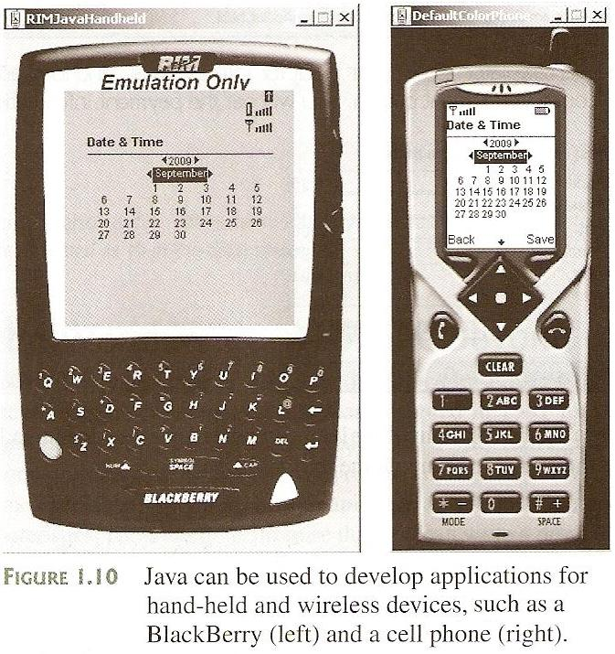
Java, the WWW, and Beyond (7)

Slide 11
The Java Language Specification, API, JDK, and IDE (1)
The Java Language Specification and Java API define the Java standard.
Java Language Specification | a technical definition of the language that includes the syntax and semantics of the Java programming language.
Application Program Interface (API) | contains predefined classes and interfaces for developing Java programs.

Slide 12
The Java Language Specification, API, JDK, and IDE (2)
There are three editions of the Java API:
  Java 2 Standard Edition (J2SE)
    used to develop client-side standalone applications or applets.
  Java 2 Enterprise Edition (J2EE)
    used to develop server-side applications, such as Java servlets and JavaServer Pages.
  Java 2 Micro Edition (J2ME)
    used to develop applications for mobile devices, such as cell phones.

Slide 13
The Java Language Specification, API, JDK, and IDE (3)
This course uses J2SE for the Java programming to illustrate the implementation of OO programming concepts.
Sun releases each version of J2SE with a Java Development Toolkit (JDK).
The latest version is J2SE 6.0 and the Java Development Toolkit is called JDK 6.0 (formerly known as JDK 1.6).
JDK consists of a set of separate programs for developing and testing Java programs, each of which is invoked from a command line.

Slide 14
The Java Language Specification, API, JDK, and IDE (4)
Java development tools include:
  JBuilder by Borland (www.borland.com)
  NetBeans Open Source by Sun (www.netbeans.org)
  Eclipse Open Source by IBM (www.eclipse.org)
  Code Warrior by Metrowerks (www.metrowerks.com)
  TextPad Editor (www.textpad.com)
  JCreator LE (www.jcreator.com)
  JEdit (www.jedit.org)
  JGrasp (www.jgrasp.org)
  BlueJ (www.bluej.org)
  DrJava (http://drjava.sourceforge.net)
we use

Slide 15
The Java Language Specification, API, JDK, and IDE (5)
A Java development tool is software that provides an integrated development environment (IDE) for rapidly developing Java programs.
Editing, compiling, building, debugging and online help are integrated in one graphical user interface.
Just enter source code in one window or open an existing file (.java) in a window, then click a button, menu item, or function key to compile and run the program.

Slide 16
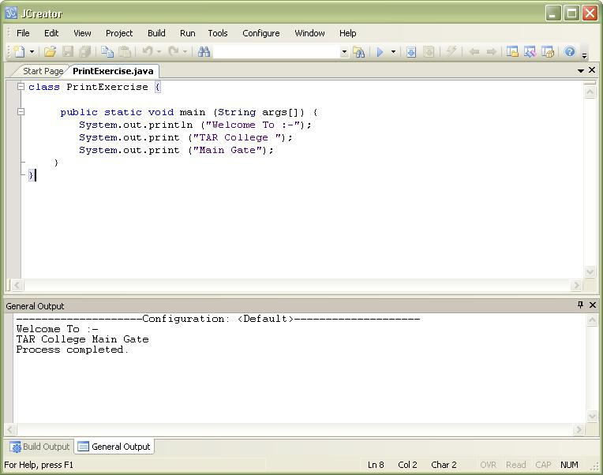
The Java Language Specification, API, JDK, and IDE (6)
JCreator LE version 4.50 user interface:
Run
Build (Compile)

Slide 17
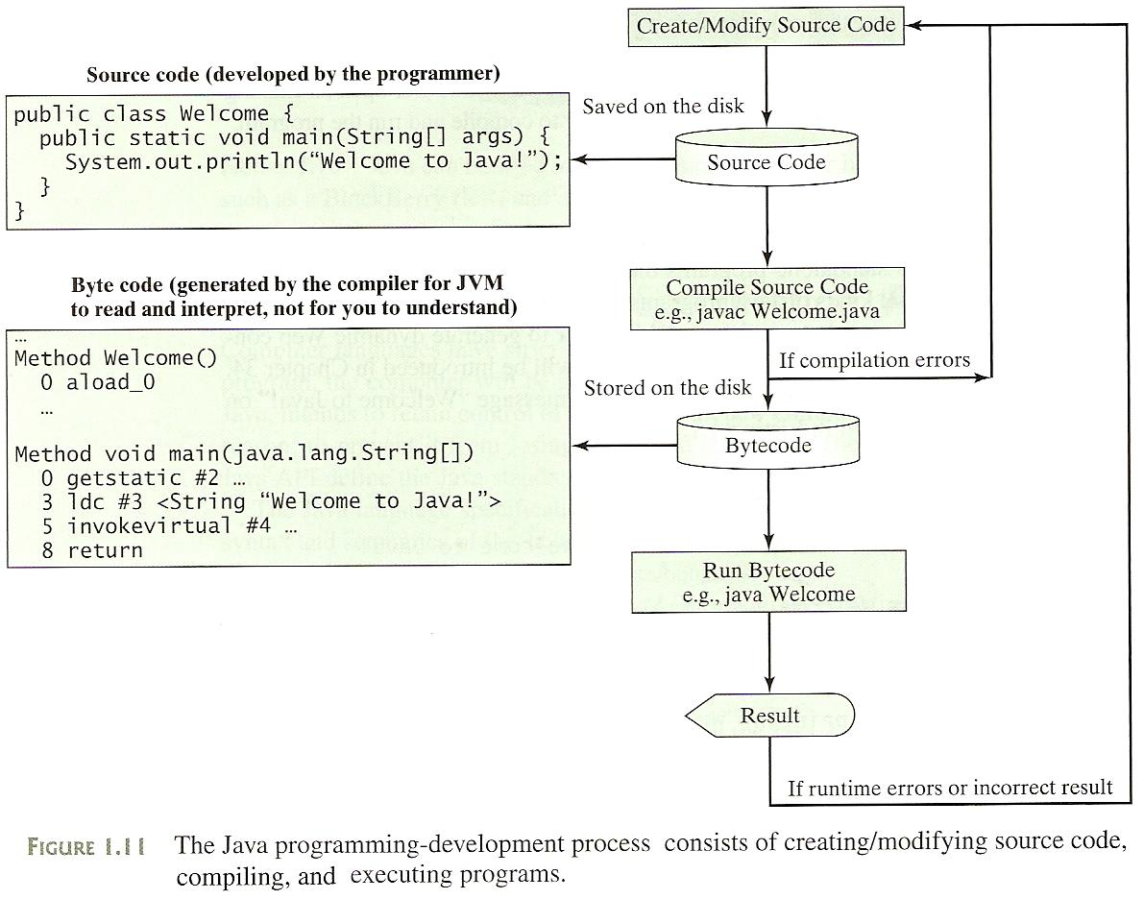
Creating, Compiling, and Executing a Java Program (1)
.java
.class

Slide 18
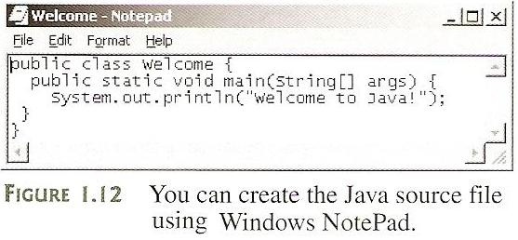
Creating, Compiling, and Executing a Java Program (2)
You have to create your program and compile it before it can be executed. This process is repetitive.
If your program has compilation errors, you have to fix them by modifying the program, then recompile it.
If your program has runtime errors or does not produce the correct result, you have to modify the program, recompile it, and execute it again.
You can use any text editor (e.g. NotePad or WordPad) to create and edit Java source code file, or you can use an IDE like JBuilder, Eclipse or NetBeans.

Slide 19
Creating, Compiling, and Executing a Java Program (3)
This file must end with the extension .java (e.g. Welcome.java) and must have the exact same name as the public class name (Welcome).
A Java compiler translates a Java source file (Welcome.java) into a Java bytecode file (Welcome.class) if there are no syntax errors.
The following command compiles Welcome.java:
javac Welcome.java
The bytecode is similar to machine instructions but is architecture-neutral and can run on any platform that has a JVM.
To execute a Java Program is to run the program’s bytecode. You can execute the bytecode on any platform with a JVM. The following command runs the bytecode: java Welcome

Slide 20
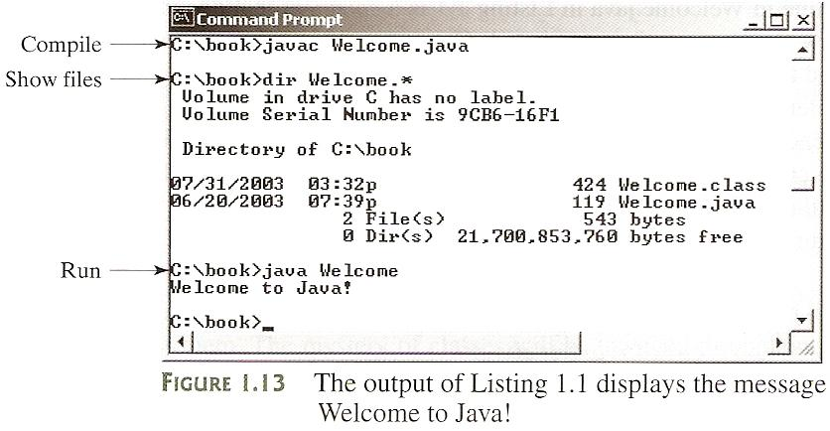
Creating, Compiling, and Executing a Java Program (4)

Slide 21
Anatomy of a Java Program (1)
The application program in Listing 1.1 has the following components:
  Comments (Similar to C language’s)
    Comment documents what the program is and how the program is constructed.
    Comments help programmers to communicate and understand the program.
    Comments are not programming statements and thus are ignored by the compiler.
    In Java, comments are preceded by two slashes (//) on a line, called a line comment, or enclosed between /* and */ on one or several lines, called a paragraph comment.
    Example:
    // This application program prints Welcome to Java!
    /* This application program prints Welcome to Java! */
    /* This application program
    prints Welcome to Java! */

Slide 22
Anatomy of a Java Program (2)
  Reserved Words (Similar to C language’s)
    Reserved words or keywords, are words (case-sensitive) that have a specific meaning to the compiler and cannot be used for other purposes in the program.
    Example: class, public, static, and void.
  Modifiers
    Java uses certain reserved words called modifiers that specify the properties of the data, methods, and classes and how they can be used.
    Example: public, static, private, final, abstract and protected.
    A public datum, method, or class can be accessed by other classes.
    A private datum, method, or class cannot be accessed by other classes.

Slide 23
Anatomy of a Java Program (3)
  Statements (Similar to C language’s)
    A statement represents an action or a sequence of actions.
    Every statement in Java ends with a semicolon (;).
    Example: System.out.println (“Welcome to Java!”);
  Blocks (Similar to C language’s)
    The braces in the program form a block that groups the components of the program.
    In Java, each block begins with an opening brace ({) and ends with a closing brace (}).
    Every class has a class block that groups the data and methods of the class.
    Every method has a method block that groups the statements in the method.
    Blocks can be nested, meaning that one block can be placed within another.

Slide 24
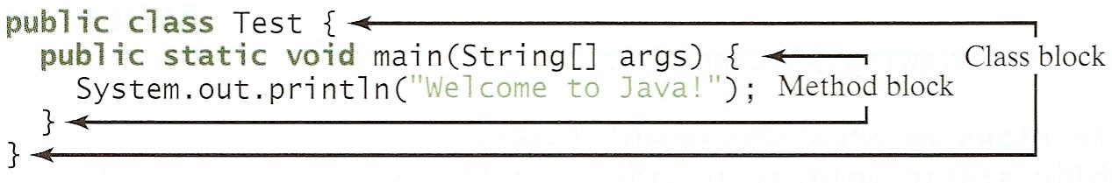
Anatomy of a Java Program (4)
  Classes
    The class is the essential Java construct.
    To program in Java, you must understand classes and be able to write and use them.
    A program is defined by using one or more classes.
  Methods (Similar to C language’s functions)
    System.out is known as the standard output object, while println is a method in the object, which consists of a collection of statements that perform a sequence of operations to display a message to the standard output device.

Slide 25
Anatomy of a Java Program (5)
  The method can be used even without fully understanding the details of how it works.
  It is used by invoking a statement with a string argument. The string argument is enclosed in parentheses [( )]. In this case, the argument is “Welcome to Java!”.
  You can call the same println method with a different arguments to print a different messages.
The main Method (Similar to C language’s)
  Every Java application must have a user-declared main method that defines where the program execution begins.
  The JVM executes the application by invoking the main method.
  Example:
  public static void main (String[] args) {
  // Statements;
  }

Slide 26
Review of learning outcomes
You should now be able to
Describe the relationship between Java and the World Wide Web (WWW).
Distinguish the terms API, IDE and JDK.
Compile and run a simple Java program.

Slide 27
To Do
Review the slides and source code for this chapter.
Read up the relevant portions of the recommended text (see next slide).

Slide 28
Reference
Main text:
Chapter 1, pp. 29 - 47
Extracted from slides by Liang, Introduction to Java Programming, 6th Edition © 2007, Prentice Hall

